Slide 1
Virtual Memory Lesson 6 Memory Compression
David Liu
2021

Slide 2
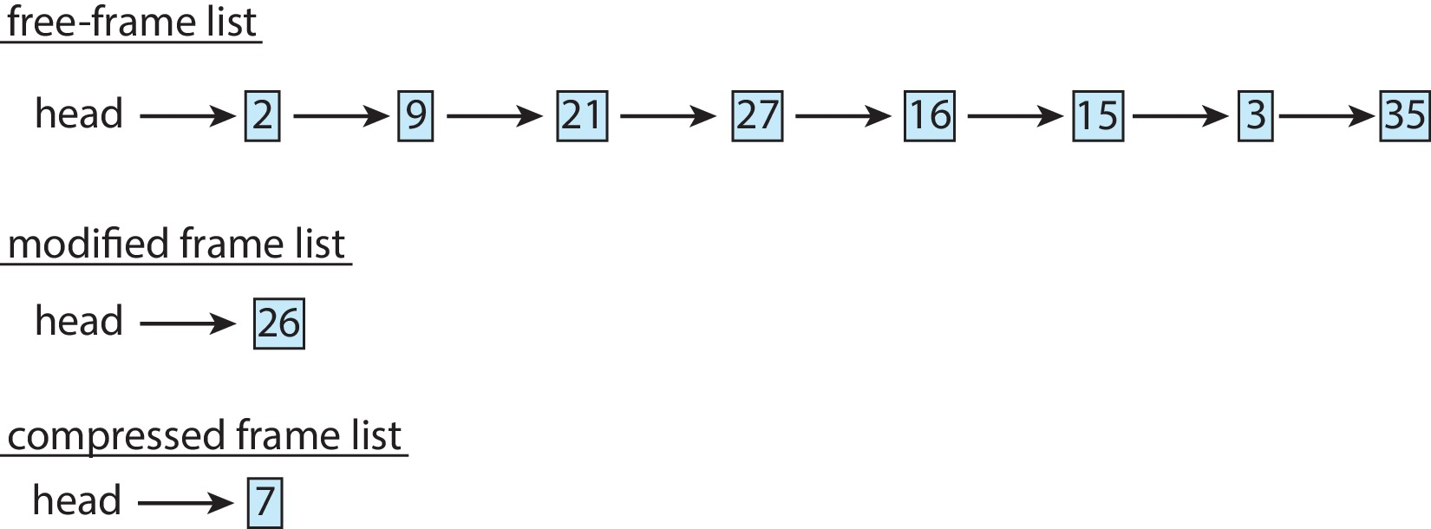
Memory Compression (Cont.)
An alternative to paging is memory compression.
Rather than paging out modified frames to swap space, we compress several frames into a single frame, enabling the system to reduce memory usage without resorting to swapping pages.

Slide 3
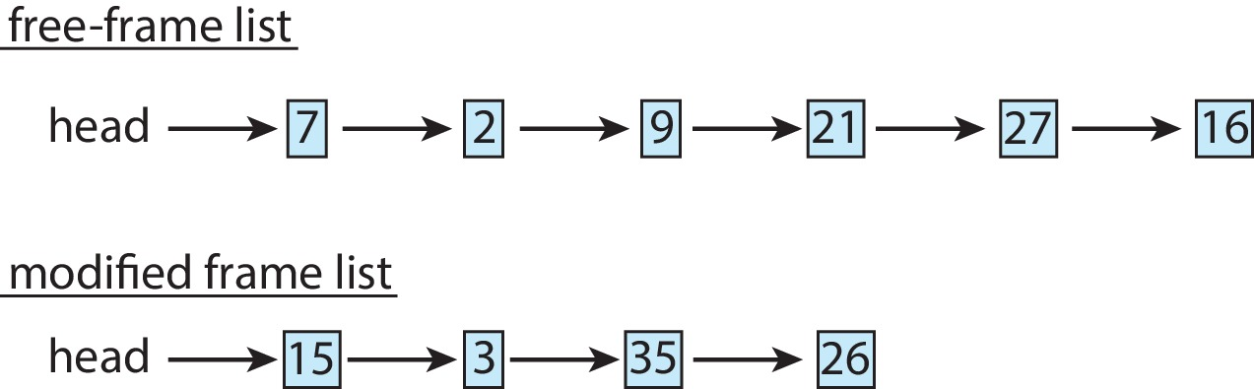
Memory Compression
Memory compression -- rather than paging out modified frames to swap space, we compress several frames into a single frame, enabling the system to reduce memory usage without resorting to swapping pages.
Consider the following free-frame-list consisting of 6 frames

Slide 4
Memory Compression
Assume that this number of free frames falls below a certain threshold that triggers page replacement.
The replacement algorithm (say, an LRU approximation algorithm) selects four frames -- 15, 3, 35, and 26 to place on the free-frame list.
It first places these frames on a modified-frame list. Typically, the modified-frame list would next be written to swap space, making the frames available to the free-frame list.
An alternative strategy is to compress a number of frames{\mdash}say, three{\mdash}and store their compressed versions n a single page frame.

Slide 5
Memory Compression (Cont.)
An alternative to paging is memory compression.
Rather than paging out modified frames to swap space, we compress several frames into a single frame, enabling the system to reduce memory usage without resorting to swapping pages.
compressed
7
26
7

